Slide 1
Classification of Handwritten Digits
CSE845 – Applied Machine Learning

Slide 2
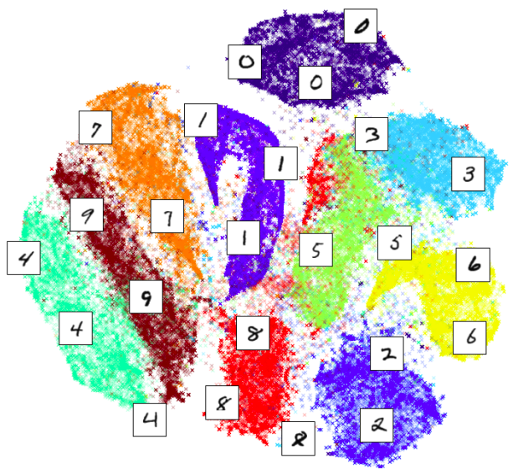
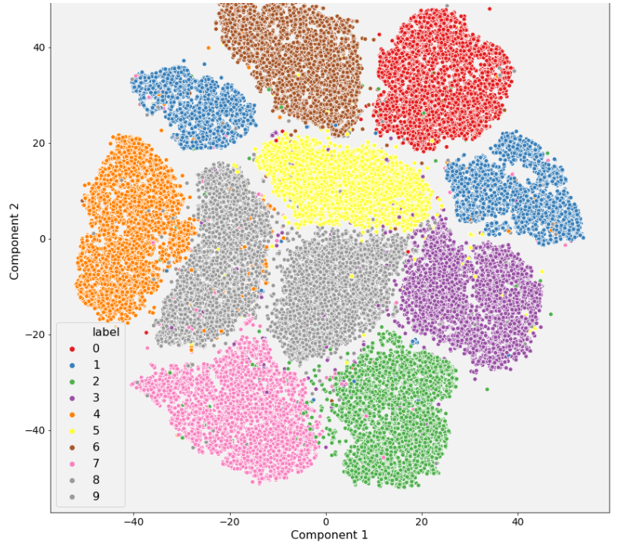
Classification of Handwritten Digits

Slide 3
Outline
Part 1: Working with images using python OpenCV
Basic concepts
Reading and Writing images
image processing routines
Lab Task ( not graded)
Part 2: Classification of Handwritten Digits
MNIST Dataset
Simple Binary Classification using Scikit SGDClassifier
Gradient Descent and Stochastic Gradient Descent Algorithms
Part 3: Python Code
Load data
Visualize MNIST
Training a Binary Classifier
Accuracy, Precision and Recall

Slide 4
Part 1: Working with images using python OpenCV
Basic concepts Reading and Writing images image processing routines Lab Task

Slide 5
Pattern Recognition
In the field of digital image processing, pattern recognition is the research area that studies the operation and design of systems that recognize patterns in data
Its primary goal is the classification of objects into a number of categories or classes.

Slide 6




Computer Vision
Approximately 70% of Human learning takes place through visual information
Cameras are the eyes of machines
Humans break down objects into features
Recognizing patterns and features in Images
Security
Automotive
Retail
Agriculture
Computer Vision Application Areas

Slide 7
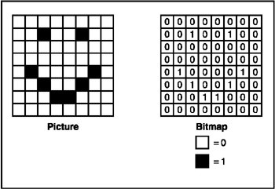

OpenCV
Pixel is the basic unit of image resolution
Images are treated as matrices
Red Green Blue (RGB) is the standard color format
OpenCV is developed by Intel
Currently most used image processing library

Slide 8
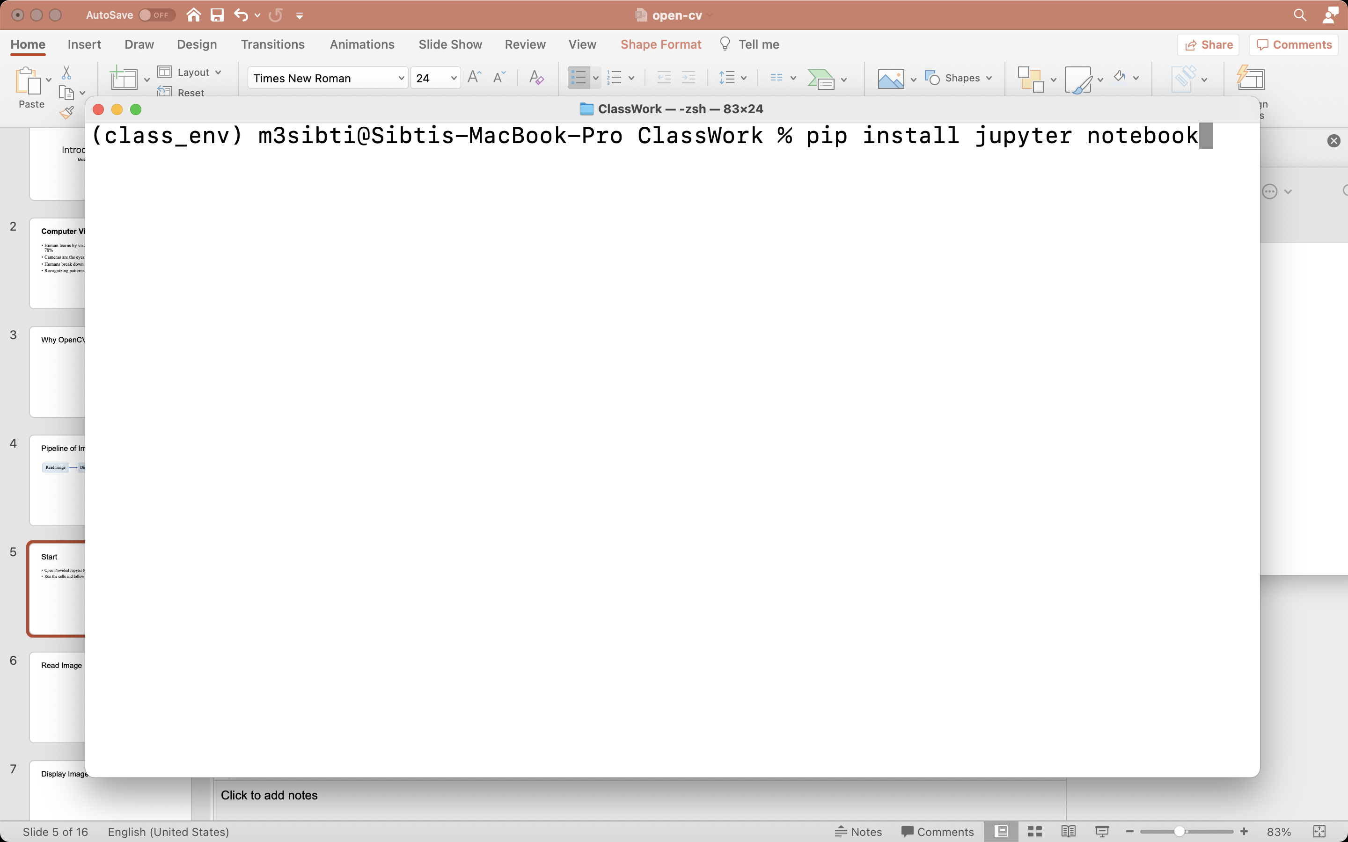
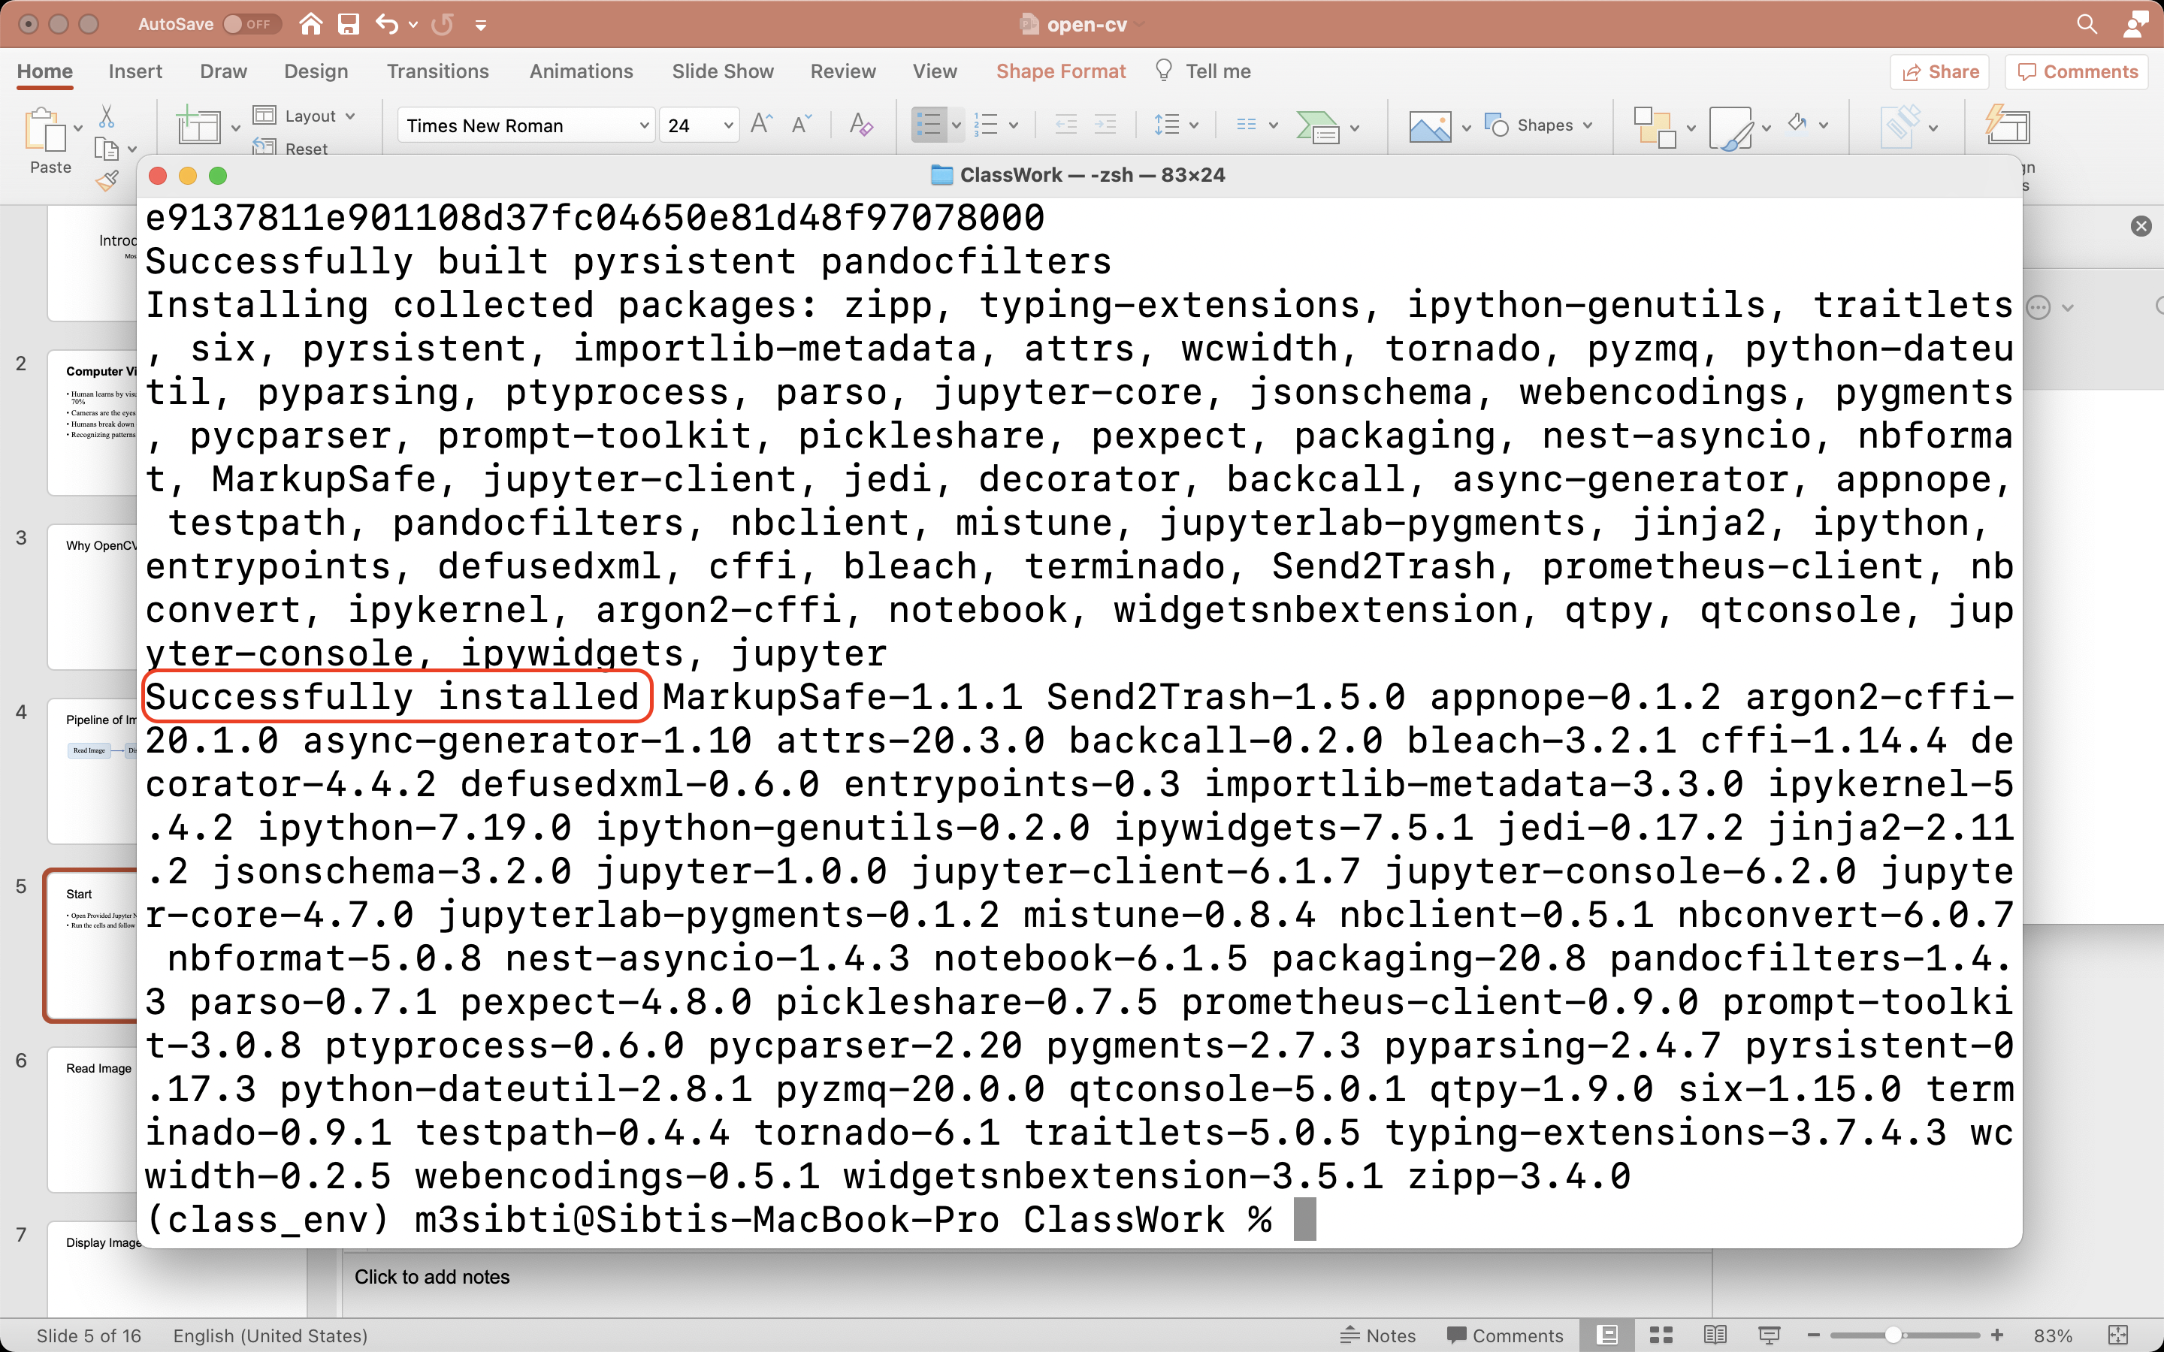
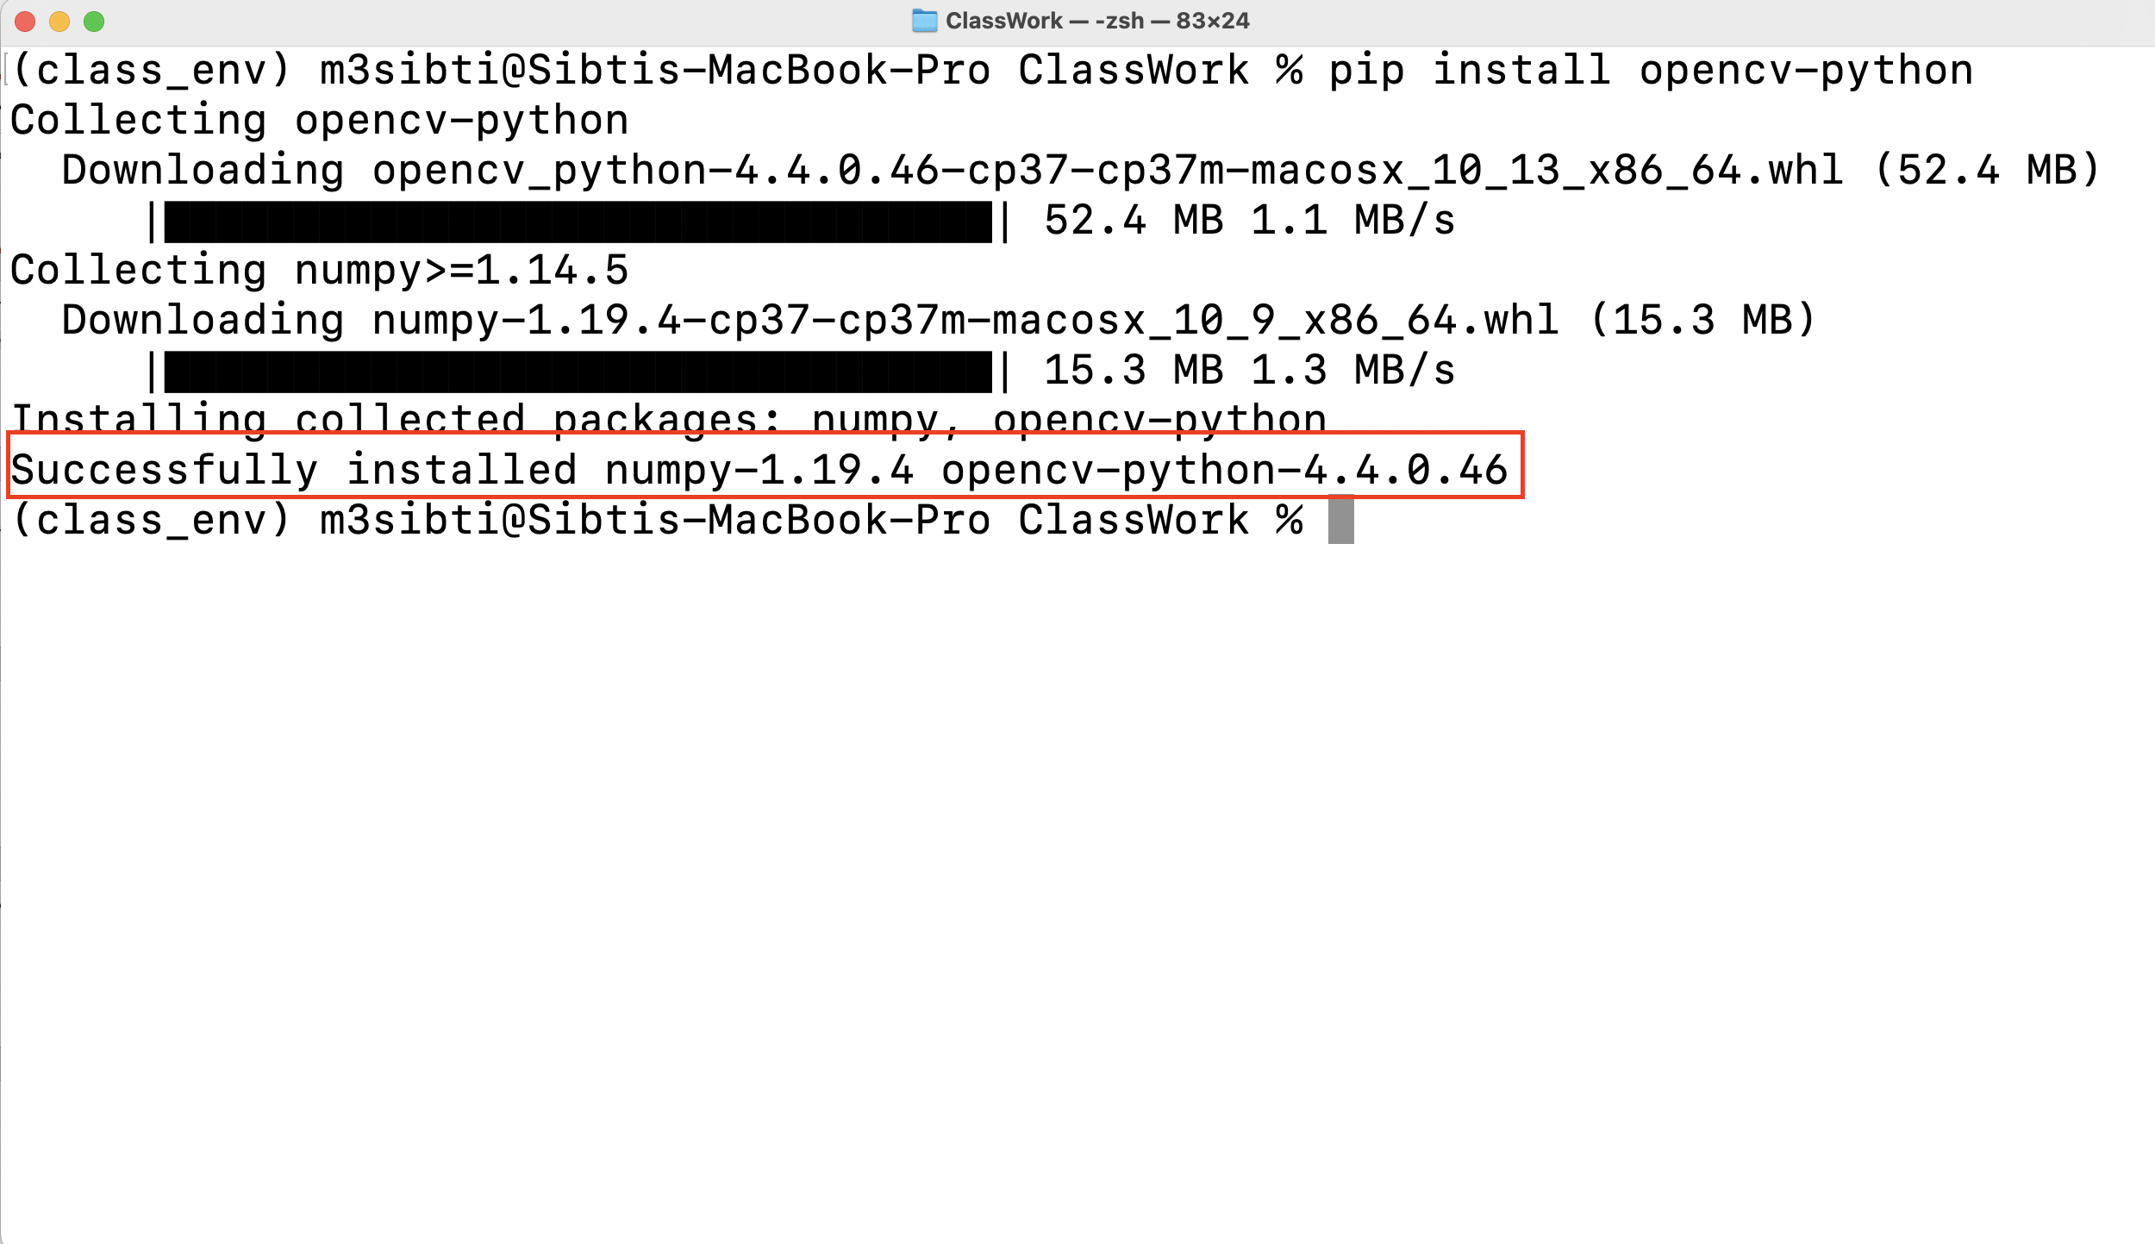
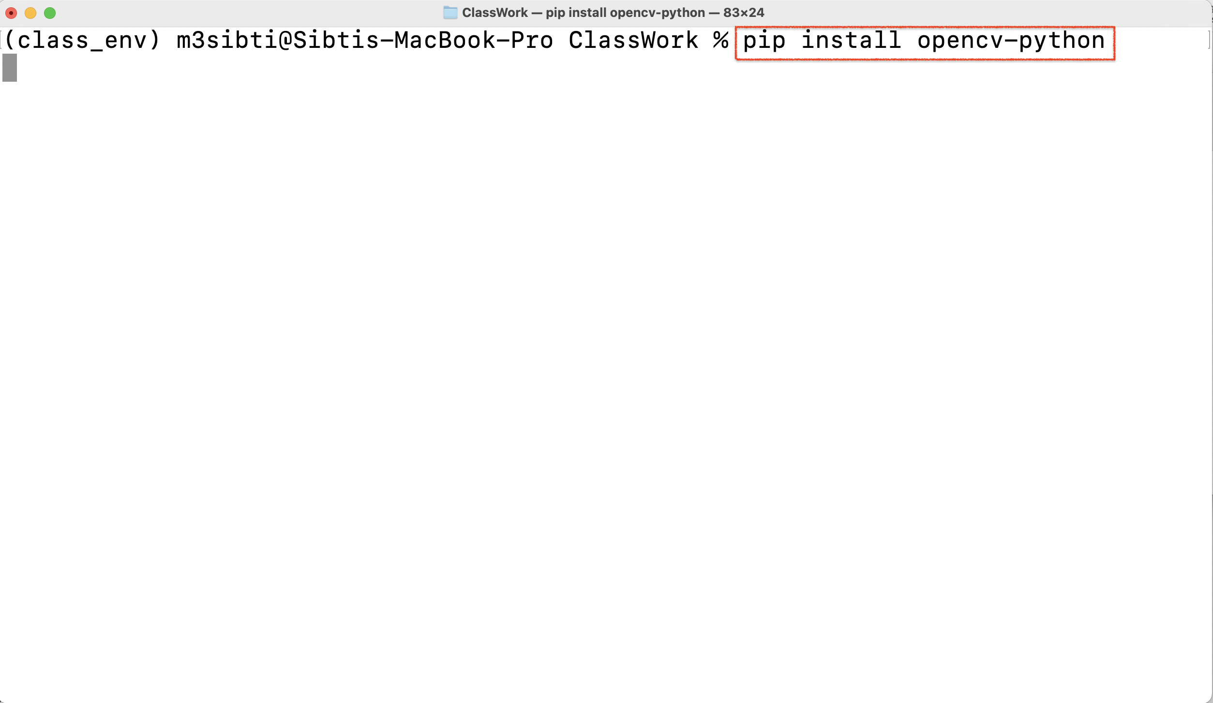
Installation
Step 1: Install Jupyter & Notebook
Step 2: Install OpenCV

Slide 9
Pipeline of Image Processing
Read Image
Display Image
Process Image
Store Image
Resize
Transforms
Split & Merge
Color Code Conversions
Edge Detection

Slide 10
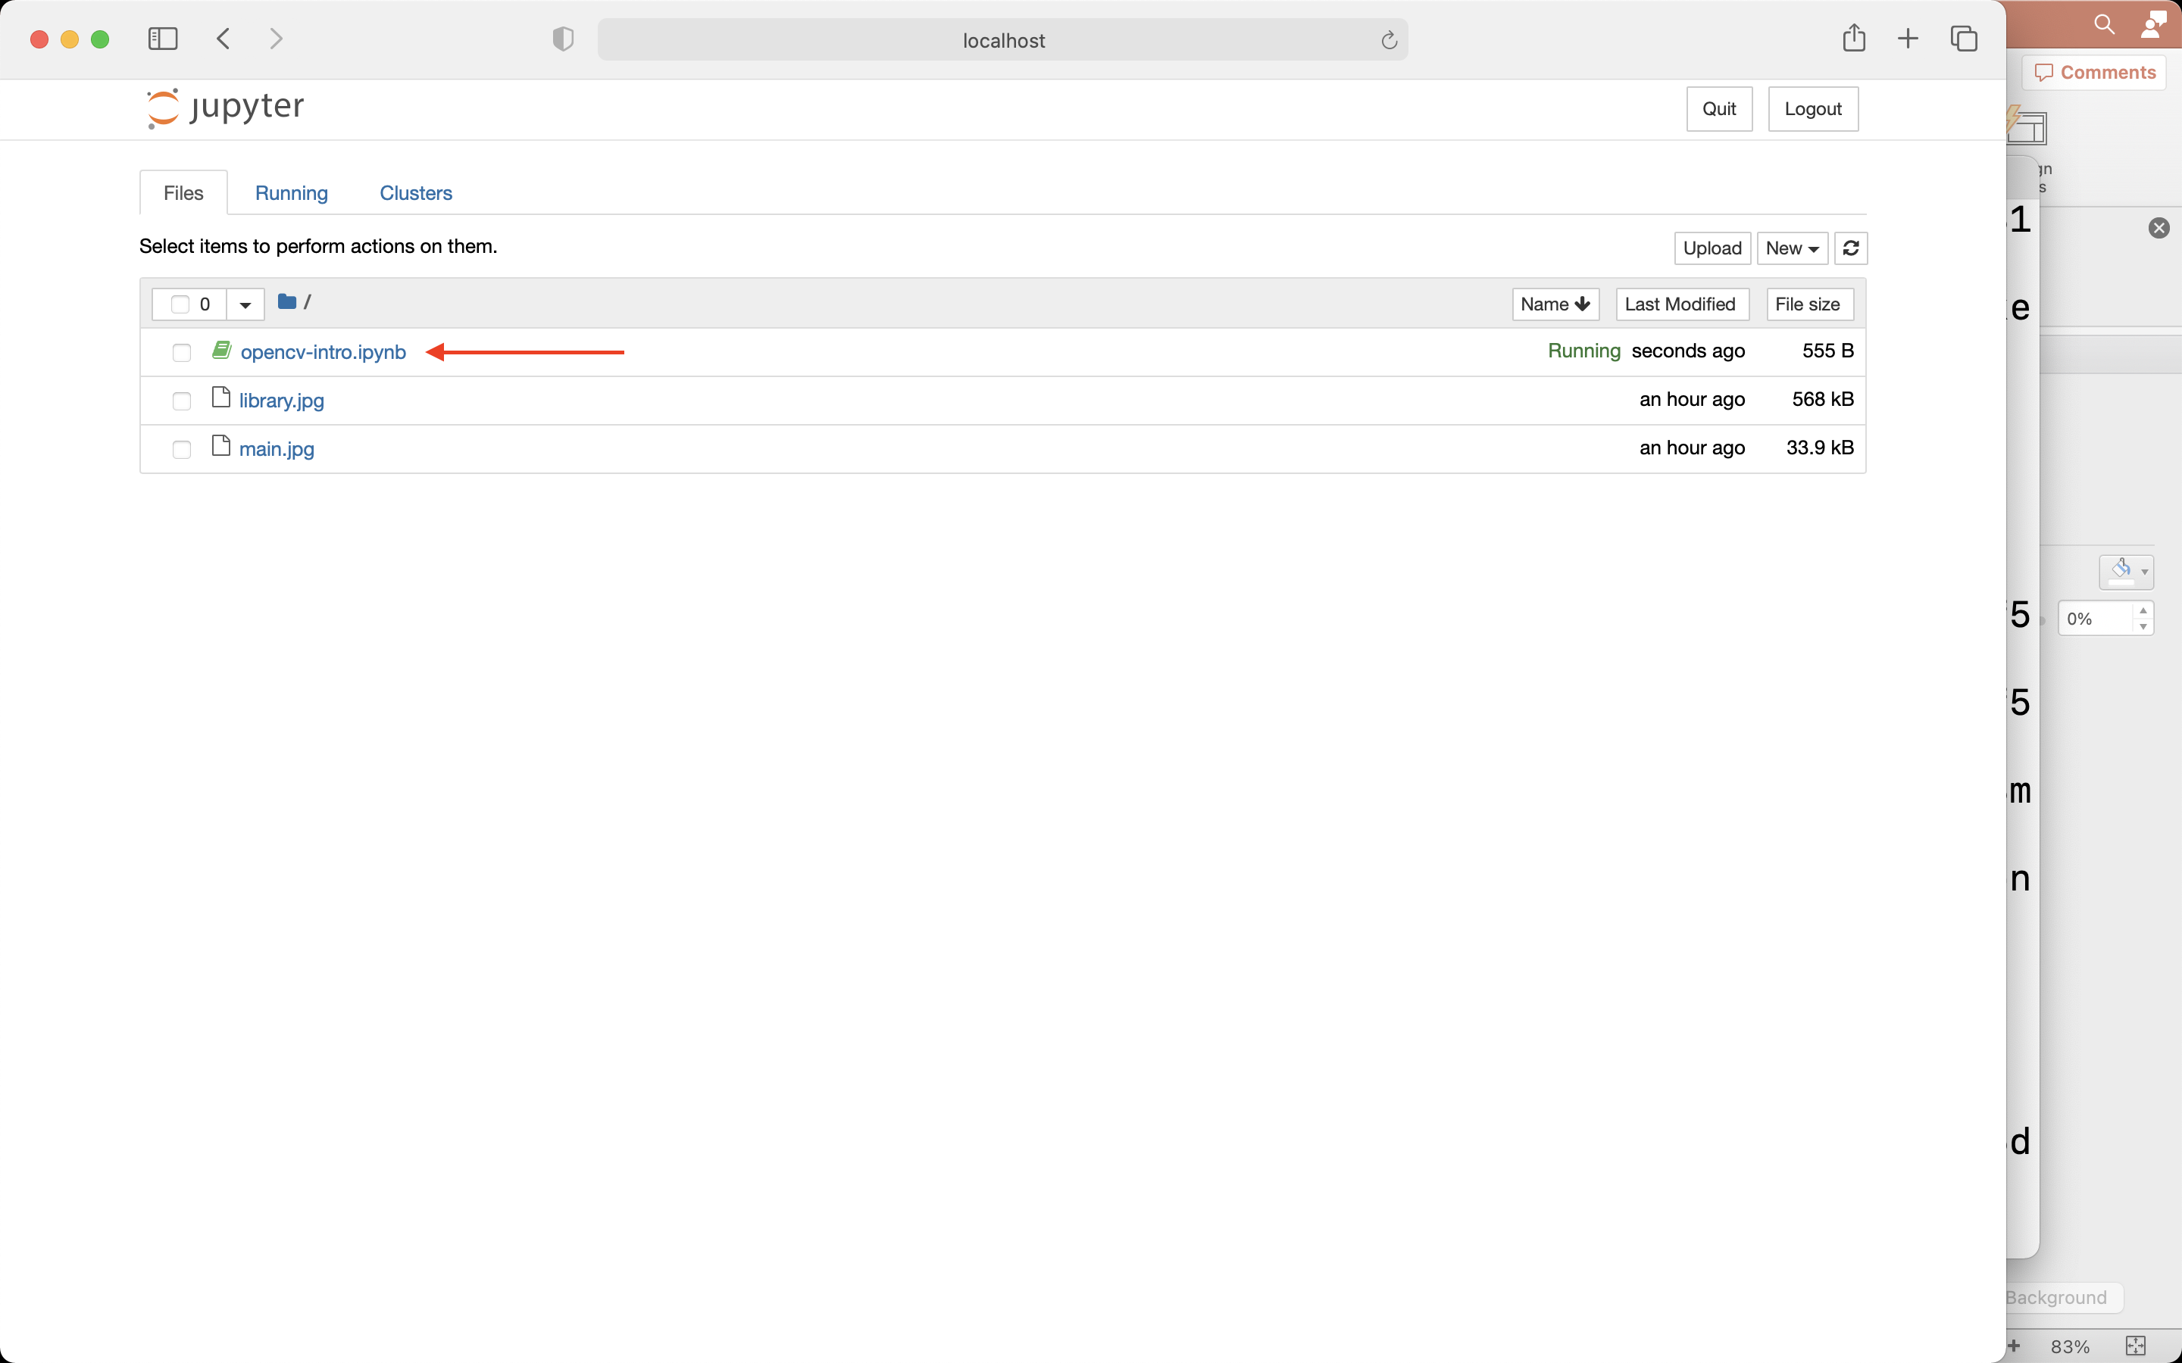
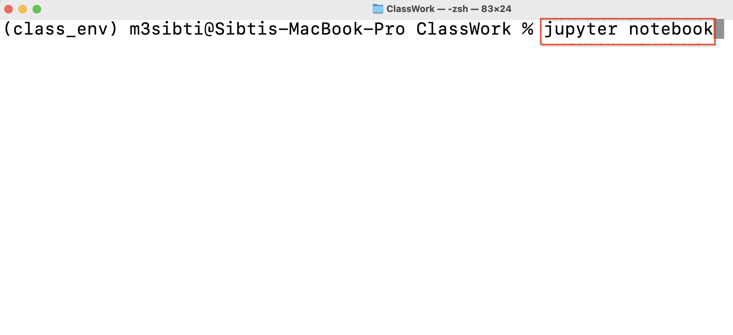
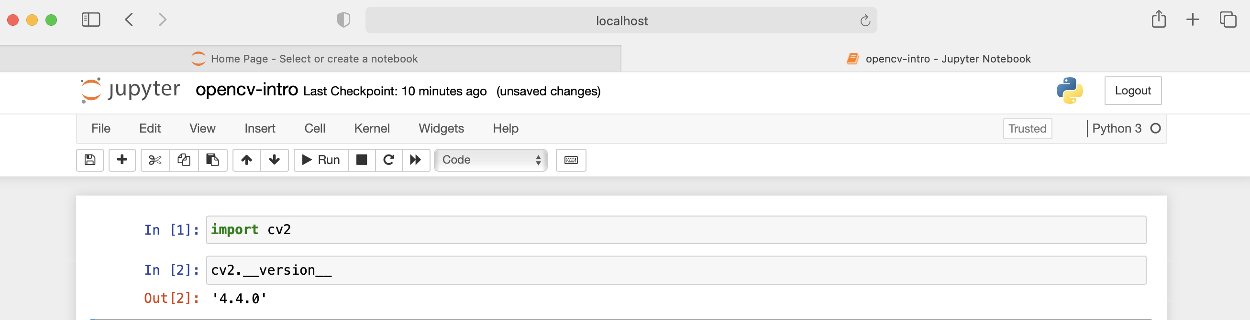
Walkthrough
Step 1: Open provided jupyter notebook
Step 2: First import the OpenCV using cv2
Note: Run the cells and follow the walkthrough
Step 3: Check the version of opencv-python

Slide 11
Walkthrough
Step 1: Open provided jupyter notebook
Step 2: First import the OpenCV using cv2
Step 3: Check the version of opencv-python
Note: Run the cells and follow the walkthrough

Slide 12
Walkthrough
Step 2: First import the OpenCV using cv2
Step 3: Check the version of opencv-python
Note: Run the cells and follow the walkthrough

Slide 13
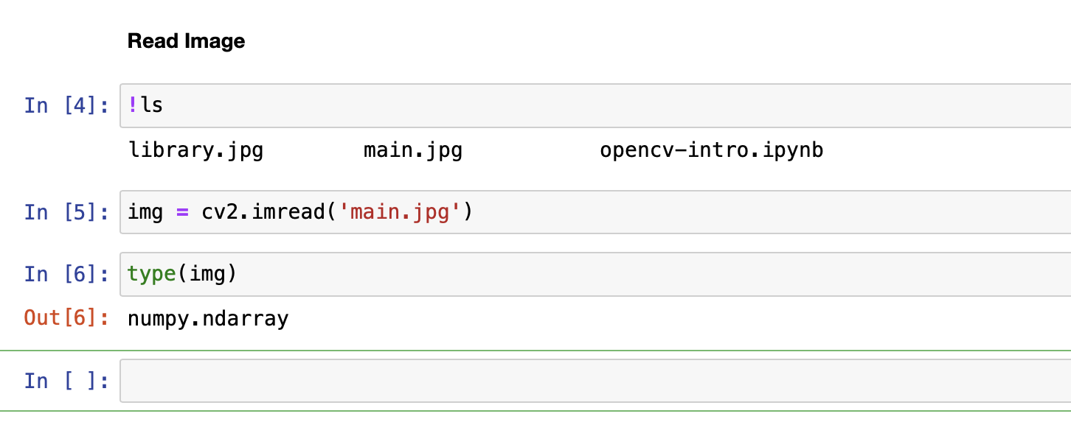
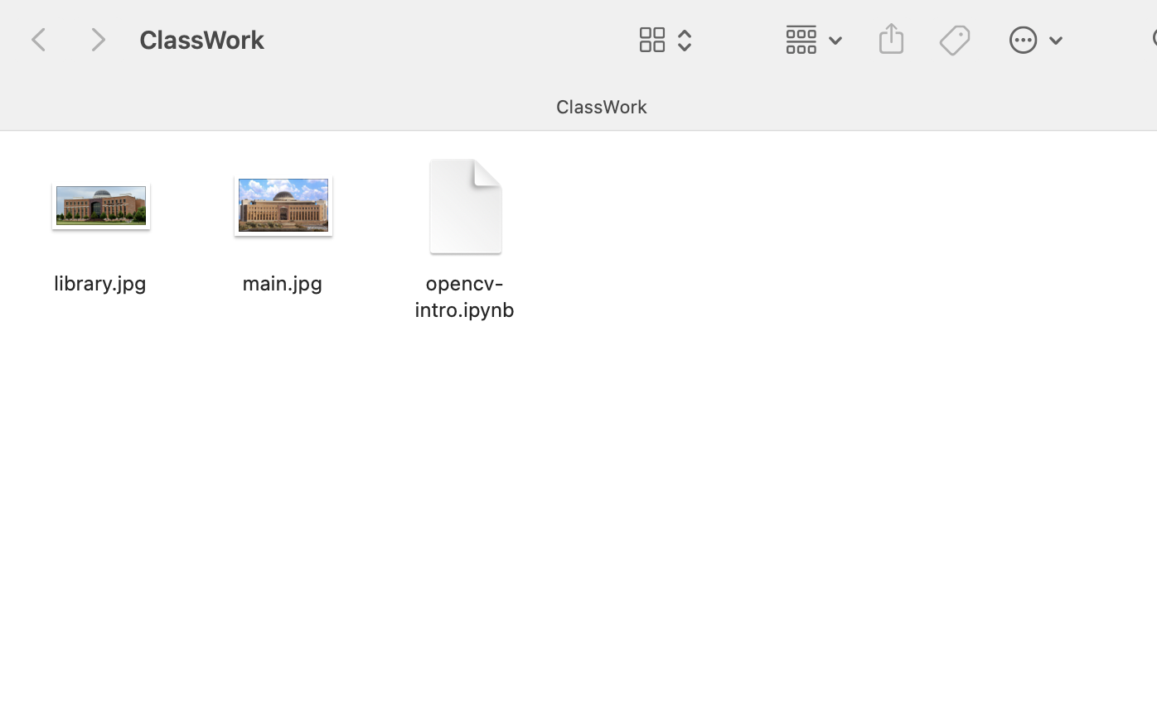
Read Image
Load image to memory (RAM)
Image loads as n-dimensional numpy array

Slide 14
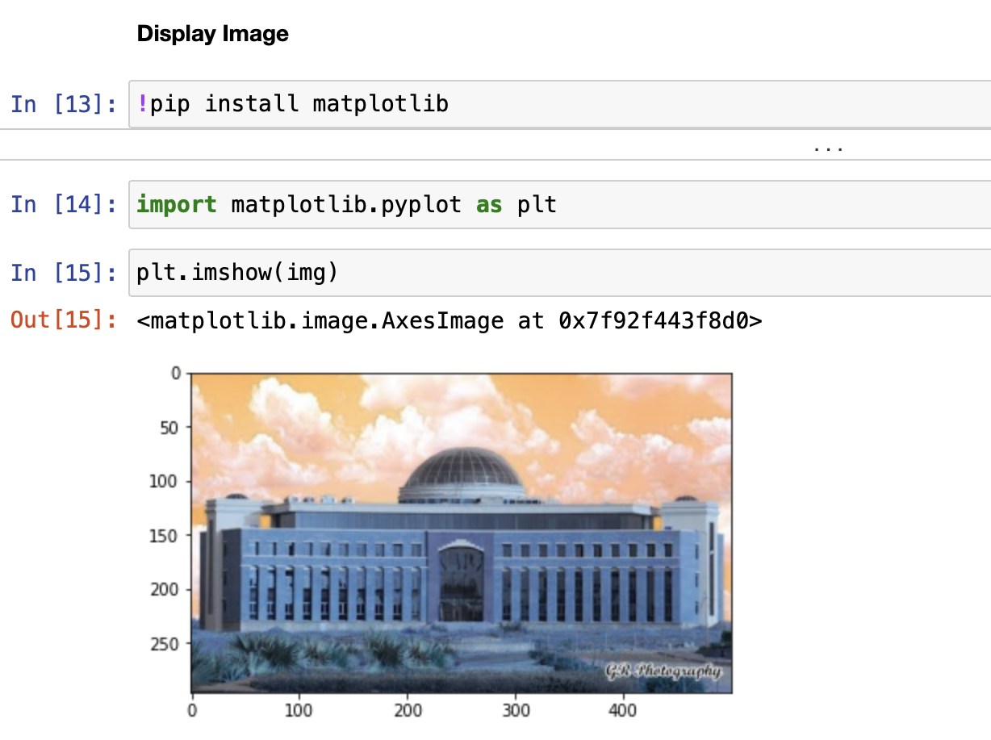
Display Image
Matplotlib plots are used to show cv2 images
Install Matplotlib using pip
Import pyplots from matplotlib
Image is in BGR format

Slide 15
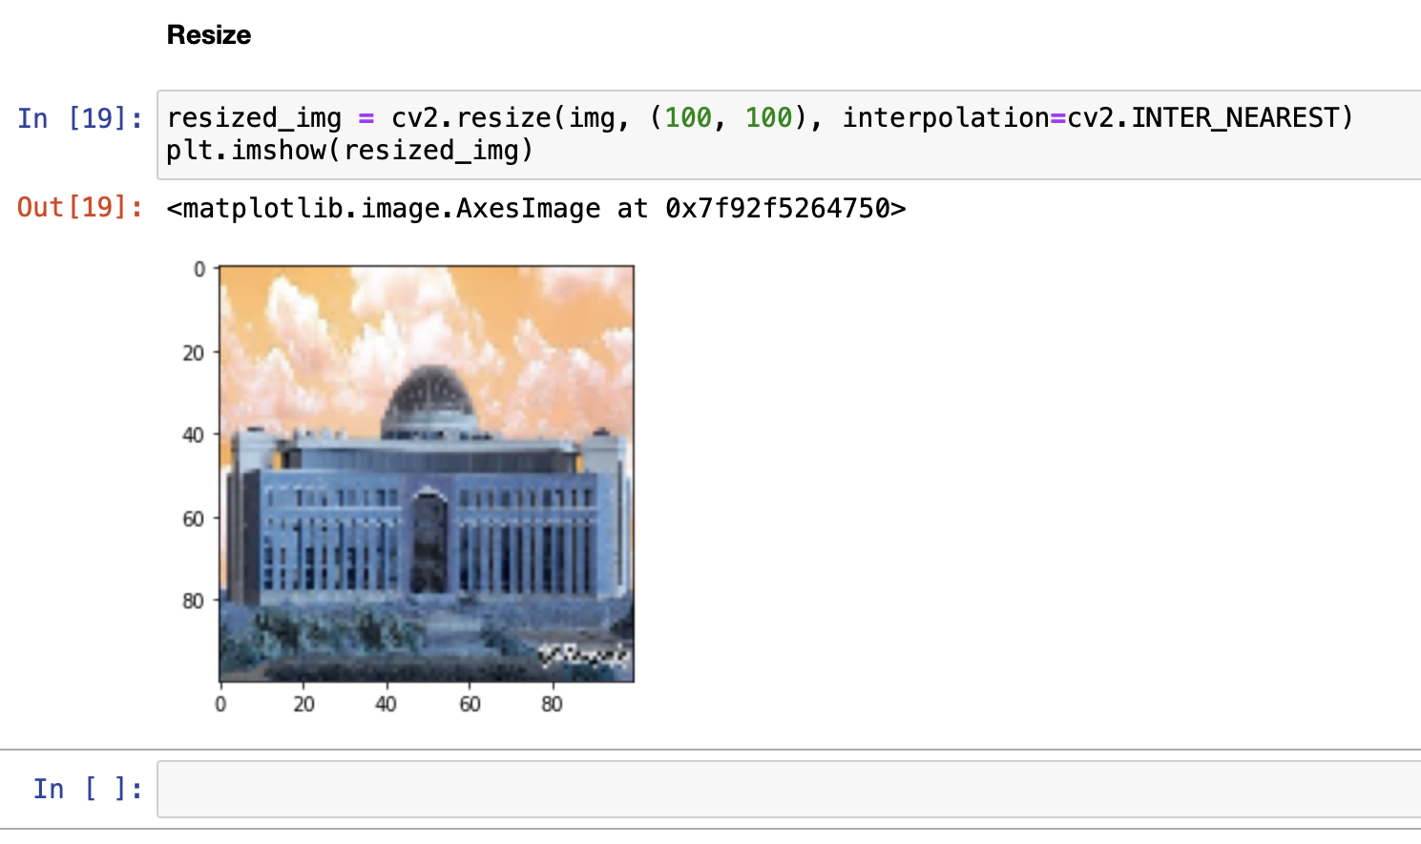
Resize
Resized to any array size
Interpolation Required
Linear and Nearest-Neighbors are mostly used

Slide 16
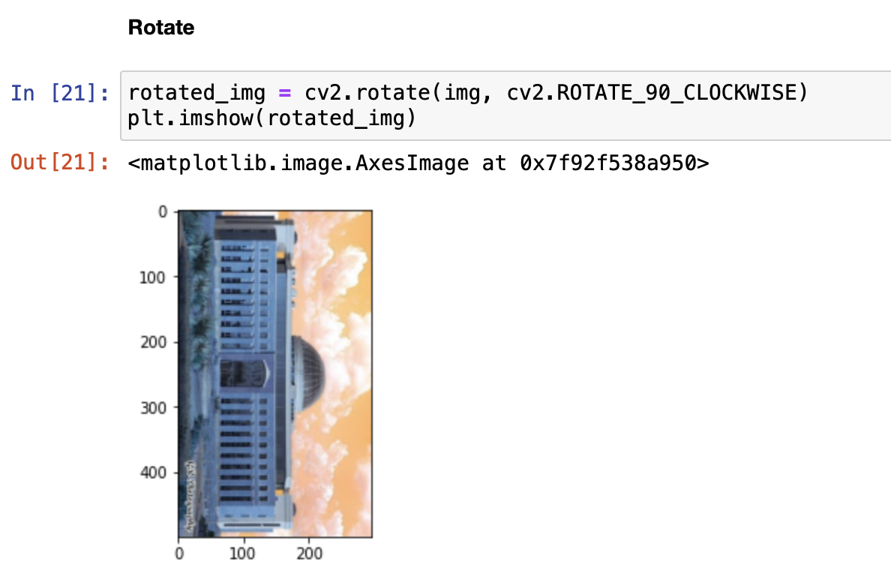
Rotate
Use cv2.rotate() function
Parameters are image and angle
If want custom rotation, check for the warpAffine() function

Slide 17
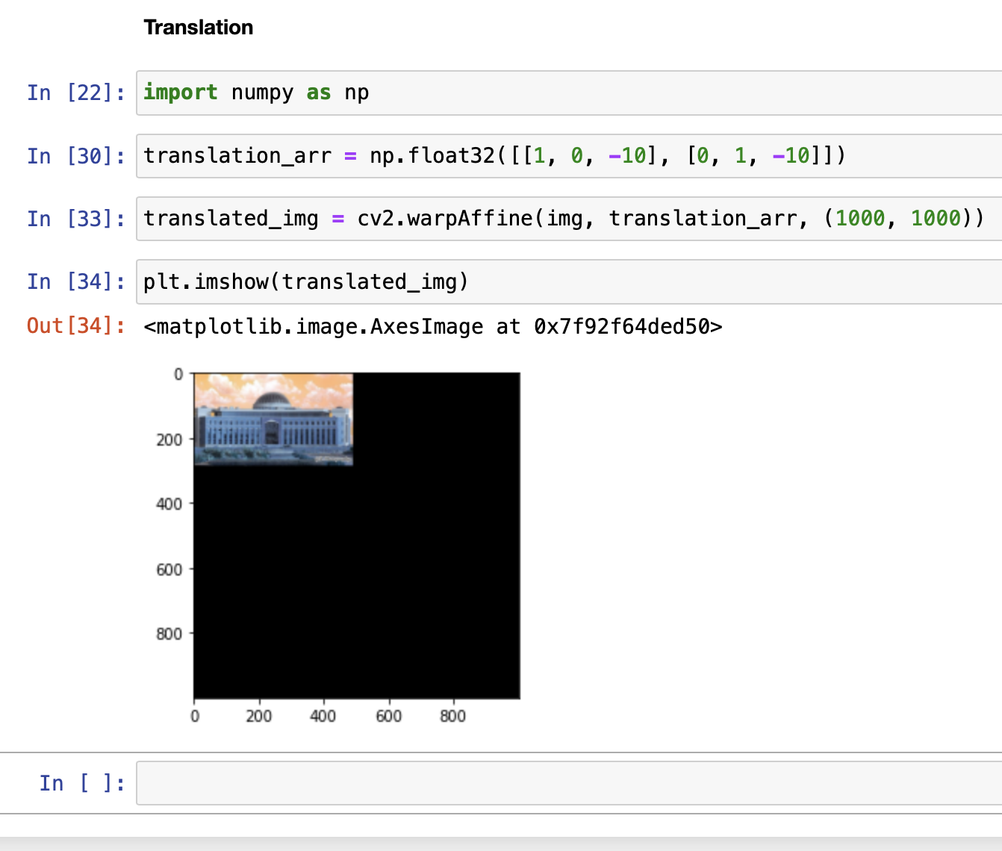
Translate
Translate image to specific size
Numpy float arrays work with warpAffine() to translate
Example of translation by 100 pixels is given

Slide 18
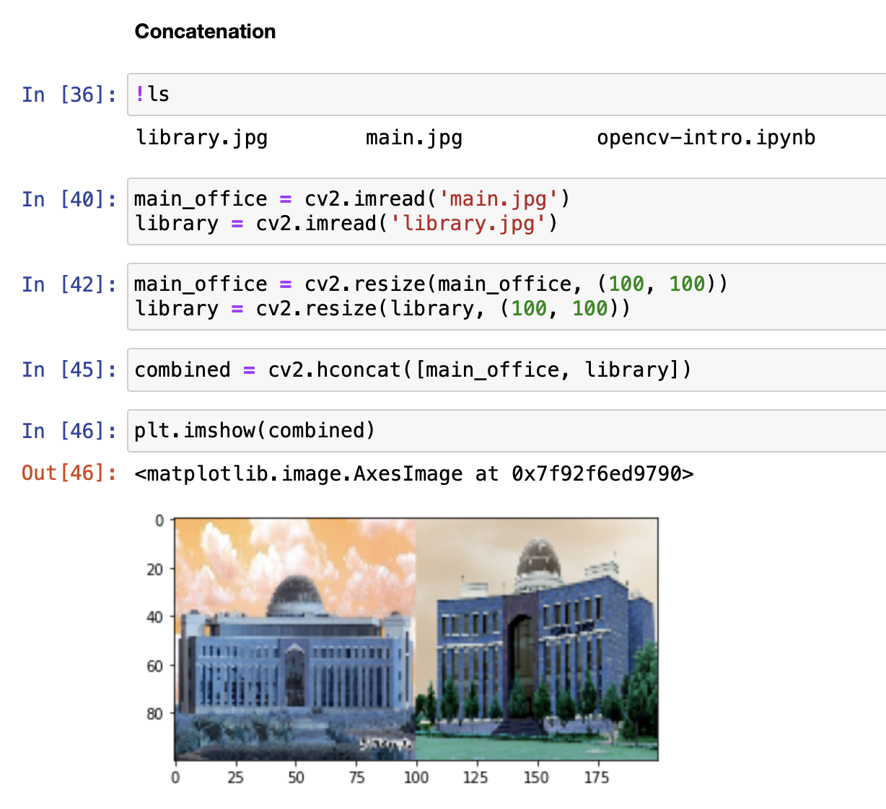
Concatenation
Combine two different images
New image is either vertically or horizontally concatenated
vconcat() & hconcat()
Image dimensions must be same

Slide 19
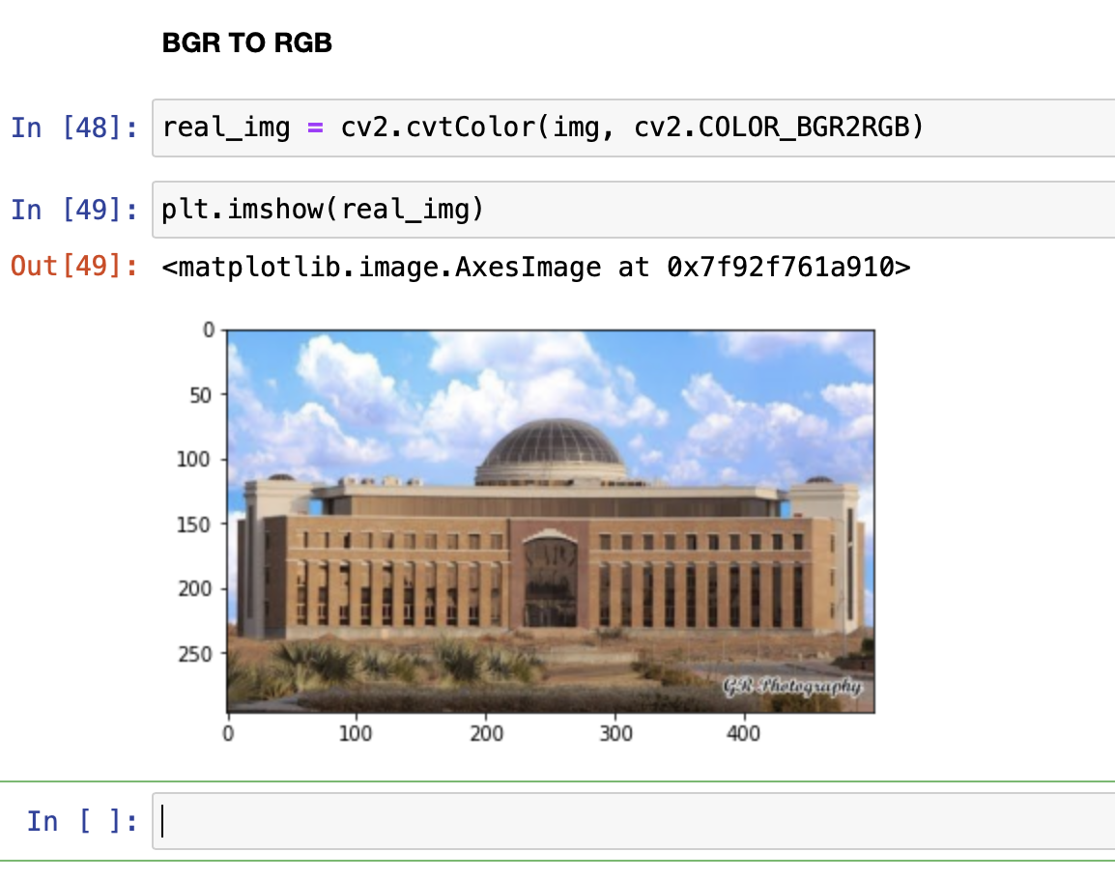
BGR to RGB
OpenCV images are in BGR
RGB is camera standard
OpenCV keeps BGR because of legacy

Slide 20
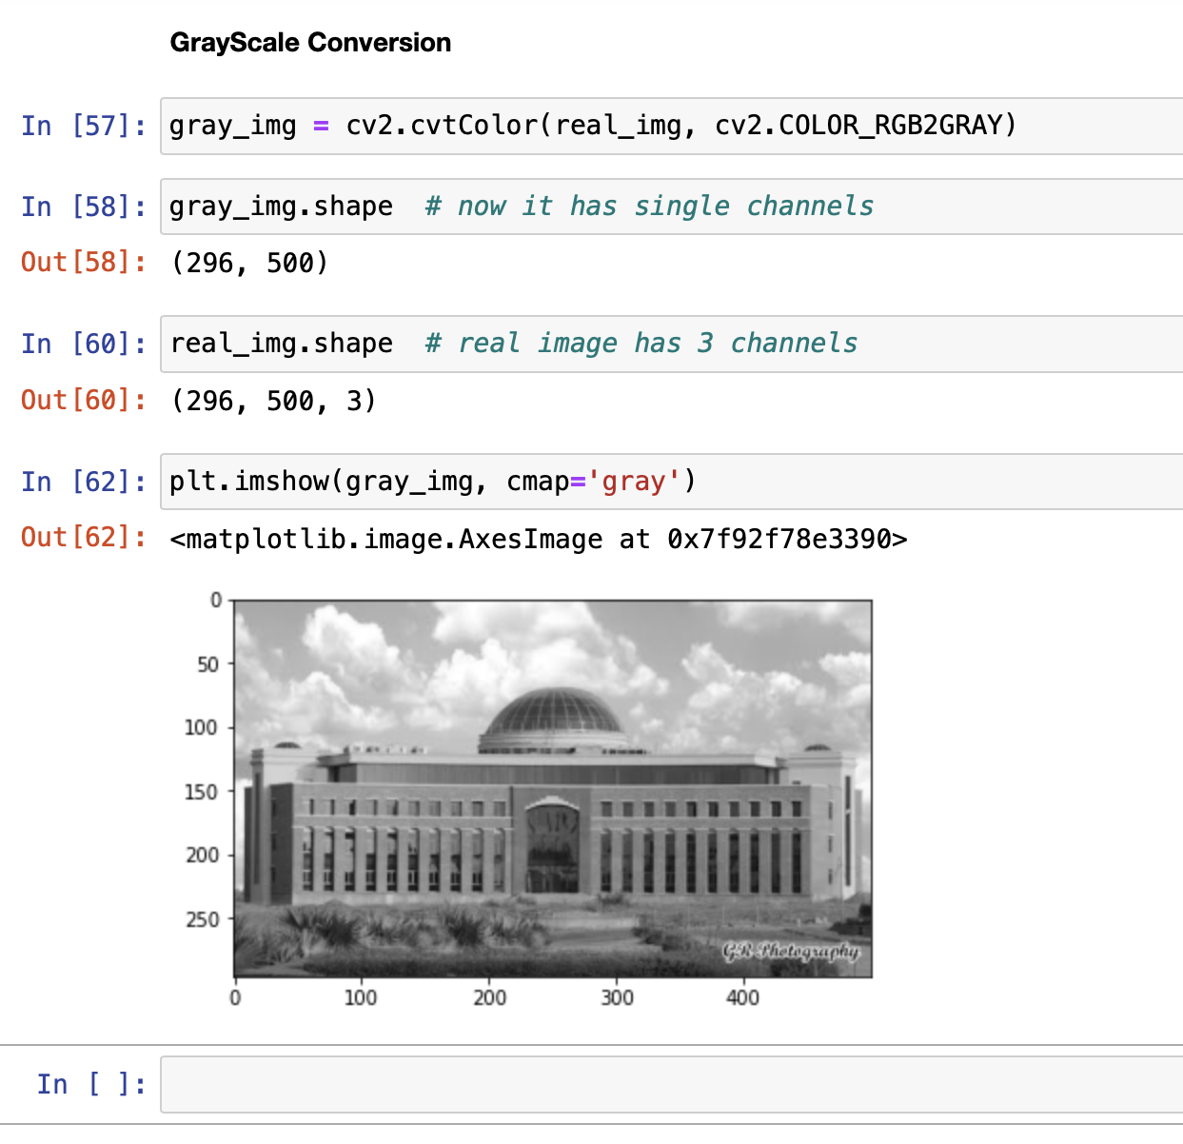
Grayscale Conversion
Change color image to grayscale
Direct read as grayscale is also possible
Edge detection is more feasible in black and white images
Color map must be ‘gray’ to visualize properly

Slide 21
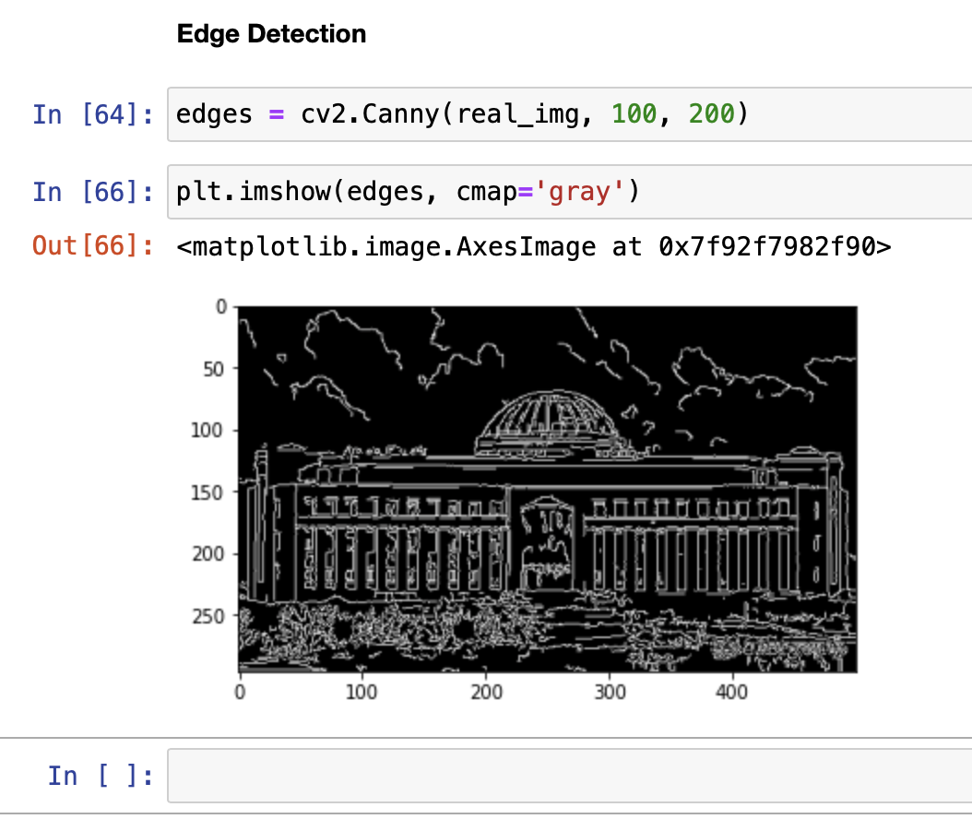
Canny Edge Detection
Edges are useful in classification tasks
Image segmentation also depends on edge detection
Canny algorithm is used in opencv-python

Slide 22
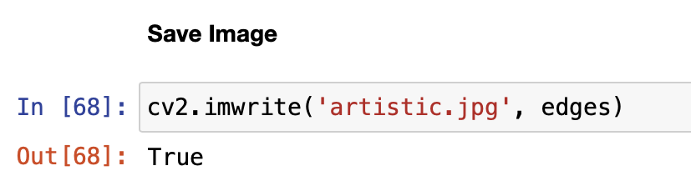
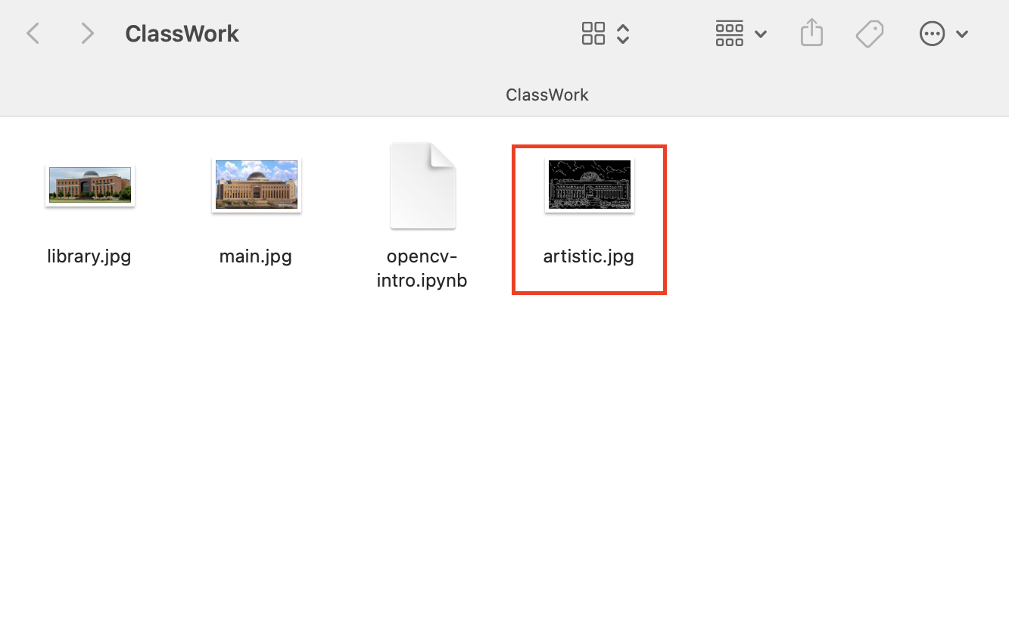
Save Image
Write image to hard drive from RAM
Writing the frames is used for saving videos
cv2.imsave() is used for storing images on disk

Slide 23
Task
Read the image of your favorite natural place using opencv
Make this image artistic using CANNY edge detector
Save this artistic image as “student-name_art.jpg”
Combine the original place with the main_office image vertically (hint: use vconcat() )
Save this concatenated image as “student-name_mocontact.jpg”
Email these two images to CR
Note: Please convert images to RGB from BGR after reading

Slide 24
Part 2: Classification of Handwritten Digits
MNIST Dataset Gradient Descent and Stochastic Gradient Descent Algorithms Simple Binary Classification using Scikit SGDClassifier

Slide 25
MNIST Dataset
MNIST dataset, which is a set of 70,000 small images of digits handwritten by high school students and employees of the US Cen‐ sus Bureau.
Scikit-Learn provides many helper functions to download popular datasets. MNIST is one of them

Slide 26
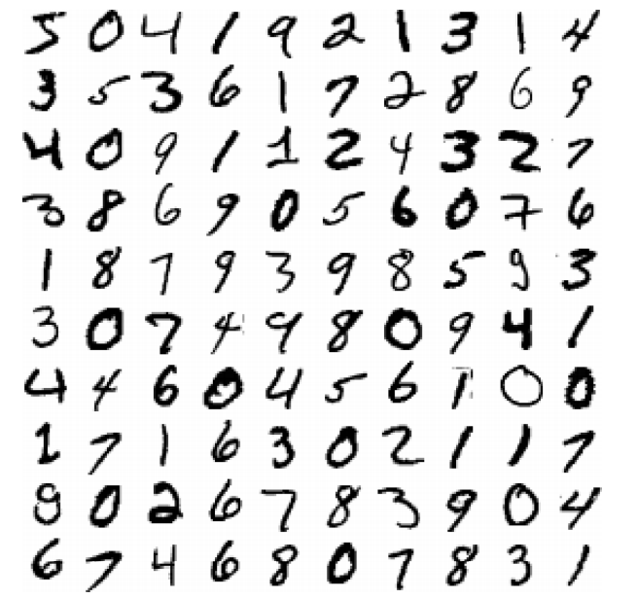
MNIST Dataset
There are 70,000 images, and each image has 784 features. This is because each image is 28 × 28 pixels

Slide 27
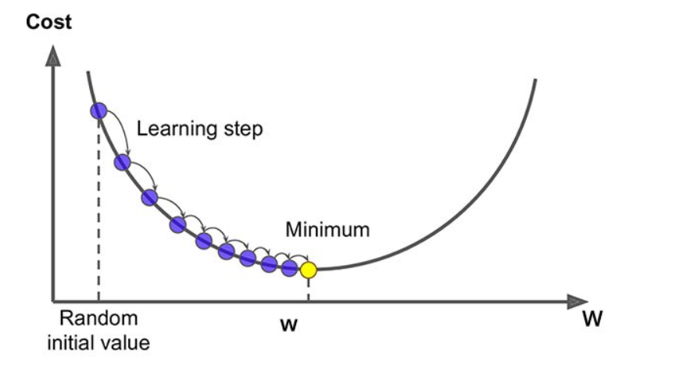
Gradient Descent
Imagine a two dimensional graph
Gradient: Slope of a surface
Gradient Descent: Descending a slope to reach the lowest point on that surface

Slide 28
Gradient Descent - Algorithm
Find the slope of the objective function with respect to each parameter/feature. In other words, compute the gradient of the function.
Pick a random initial value for the parameters. (To clarify, in the parabola example, differentiate “y” with respect to “x”. If we had more features like x1, x2 etc., we take the partial derivative of “y” with respect to each of the features.)
Update the gradient function by plugging in the parameter values.
Calculate the step sizes for each feature as : step size = gradient * learning rate.
Calculate the new parameters as : new params = old params -step size
Repeat steps 3 to 5 until gradient is almost 0.

Slide 29
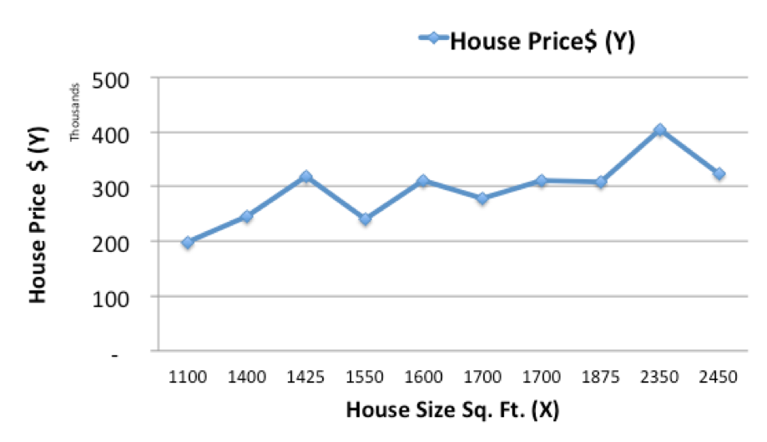
Example – Predicting House Prices
https://www.kdnuggets.com/2017/04/simple-understand-gradient-descent-algorithm.html

Slide 30
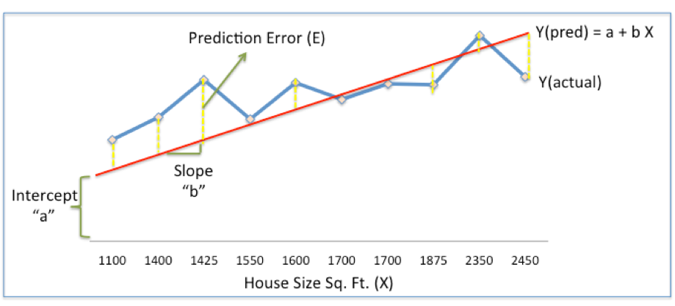
Minimizing Prediction Error is an Optimization Problem

Slide 31
Gradient Descent Algorithm
Step 1: Initialize the weights(a & b) with random values and calculate Error (SSE)
Step 2: Calculate the gradient i.e. change in SSE when the weights (a & b) are changed by a very small value from their original randomly initialized value. This helps us move the values of a & b in the direction in which SSE is minimized.
Step 3: Adjust the weights with the gradients to reach the optimal values where SSE is minimized
Step 4: Use the new weights for prediction and to calculate the new SSE
Step 5: Repeat steps 2 and 3 till further adjustments to weights doesn’t significantly reduce the Error

Slide 32
Stochastic Gradient Descent
Gradient Descent is Computationally Intensive
SGD randomly picks one data point from the whole data set at each iteration to reduce the computations enormously
It is also common to sample a small number of data points instead of just one point at each step and that is called “mini-batch” gradient descent

Slide 33
Part 3: Python Code
Load data Visualize MNIST Training a Binary Classifier Accuracy, Precision and Recall

Slide 34
Download / Import Dataset
import tensorflow as tf
mnist = tf.keras.datasets.mnist
(x_train, y_train), (x_test, y_test) = mnist.load_data()

Slide 35
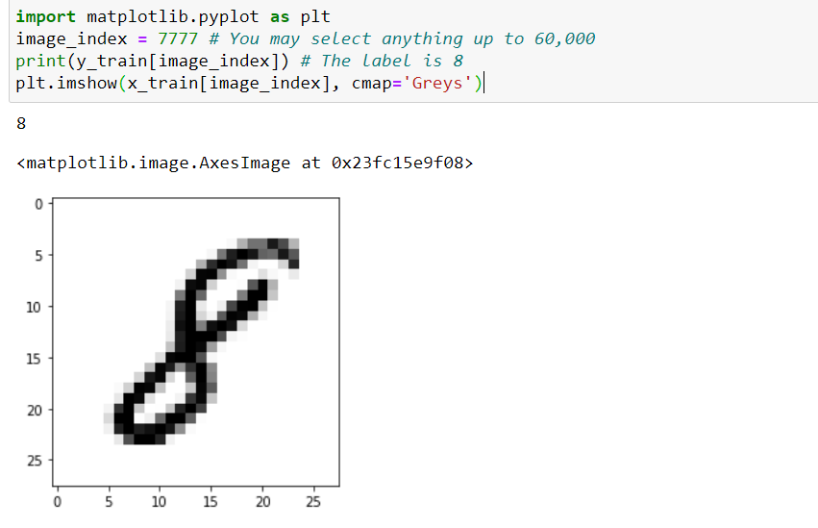
Visualize MNIST

Slide 36
Flatten 28*28 images to a 784 vector for each image
num_pixels = x_train.shape[1] * x_train.shape[2]
x_train = x_train.reshape((x_train.shape[0], num_pixels)).astype('float32')
x_test = x_test.reshape((x_test.shape[0], num_pixels)).astype('float32')

Slide 37
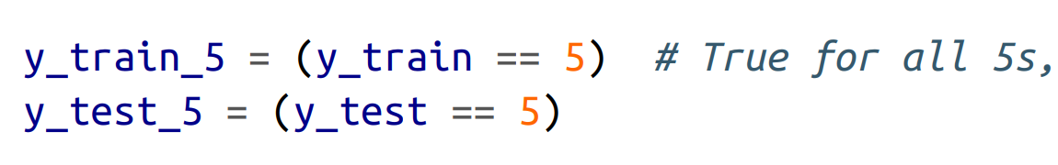
Training a Binary Classifier
Let’s simplify the problem for now and only try to identify one digit—for example, the number 5.
This “5-detector” will be an example of a binary classifier, capable of distinguishing between just two classes, 5 and not-5.

Slide 38
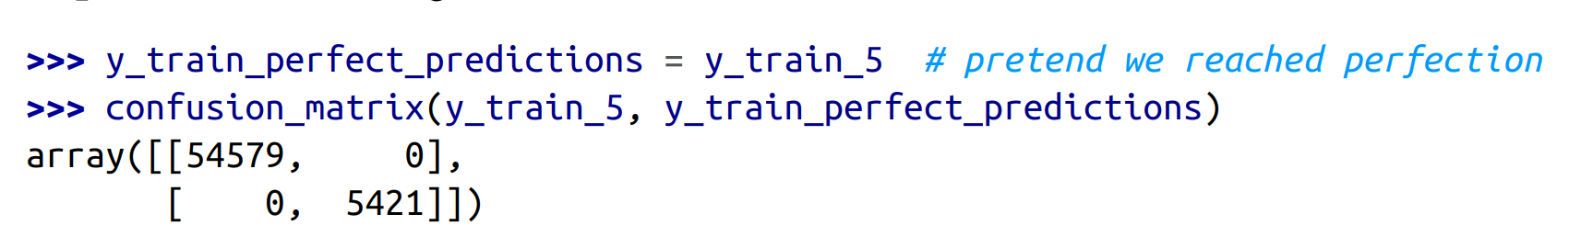
Perfect Classifier
A perfect classifier would have only true positives and true negatives, so its confusion matrix would have nonzero values only on its main diagonal (top left to bottom right):

Slide 39
Confusion Matrix - ScikitLearn
from sklearn.metrics import confusion_matrix
confusion_matrix(y_train_5, y_train_pred)
Array ( [ [53057, 1522] ,
[ 1325, 4096 ] ])

Slide 40
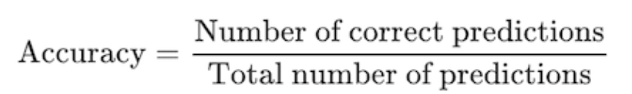
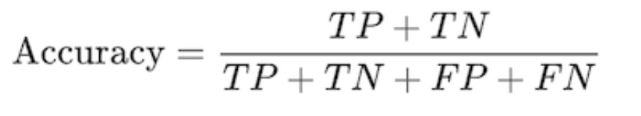
Accuracy of the classifier

Slide 41
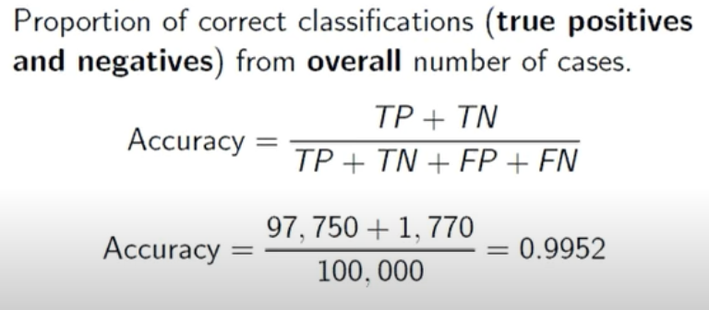
Example

Slide 42
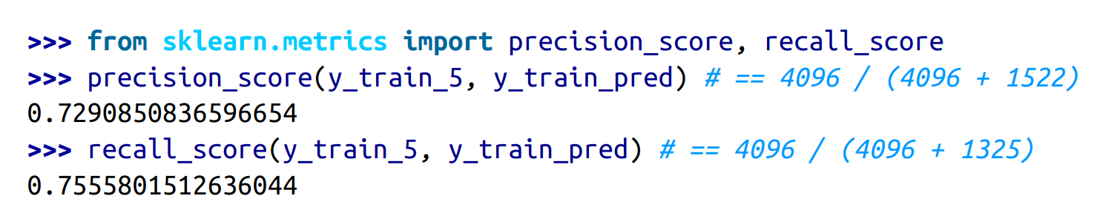
Precision and Recall

